Slide 1

Stock Market Forecasting and Analysis
By
Mayuri Darshan Pandit,
MIT Vishwaprayag University, Solapur

Slide 2

Index
Introduction
Problem statement
Objective
Data Collection
Exploratory Data Analysis (EDA)
ER- Diagram
Results and Insights

Slide 3
Introduction
Stock market is a financial marketplace where buyers and sellers trade shares of publicly-listed companies.
It serves as a platform for companies to raise capital by issuing stocks (equity) to the public, and for investors to buy and sell these stocks.
It includes Primary and Secondary Markets.
Shares and Ownership

Slide 4
Introduction
Primary Market:
In which new securities are issued and sold for the first time.
Companies raise capital by issuing stocks through Initial Public Offerings (IPOs).
Secondary Market:
In which once securities are issued, they are traded on the secondary market (stock exchanges).
This is where investors buy and sell existing shares among themselves.

Slide 5
Introduction
Stock Exchanges:
Exchanges provide a platform for transparent and regulated trading.
Eg. National Stock Exchange (NSE), Bombay Stock Exchange (BSE)
Shares and Ownership:
Companies divide ownership into shares.

Slide 6
Problem statement
To predict future prices of a stock based on the historical prices and related to the stock.

Slide 7
Objective
The purpose is to gain insights into stock price trends and make informed decisions.
The gaining insight require:
Education
Understand the Basics about the Company
Read Books and Articles about the Company
Defining Investment Goals
Outline your financial goals, whether they involve short-term gains, long-term growth, or income generation.

Slide 8
Objective
Research Companies:
Fundamental Analysis:
Evaluate a company's financial health and growth prospects.
Look at financial statements, earnings reports, and other relevant data.
Industry Analysis:
Understanding the industry trends and dynamics that may impact the company's performance.

Slide 9
Objective
Technical Analysis:
Use technical analysis tools to study
Historical price movements
Identify patterns
Common technical indicators include
Moving averages,
Relative Strength Index (RSI)

Slide 10
Data Collection
Describing data sources
(e.g., Google finance, Yahoo Finance).
Types of data collected
(historical stock prices, trading volume).

Slide 11
Exploratory Data Analysis (EDA)
Visualizations of stock price trends over time.
line chart is useful for showing the general trend of a stock over a specific time period
Candlestick charts display the open, high, low, and close prices for each time period.
Bar charts can be used to show the daily or monthly price movements of a stock.

Slide 12
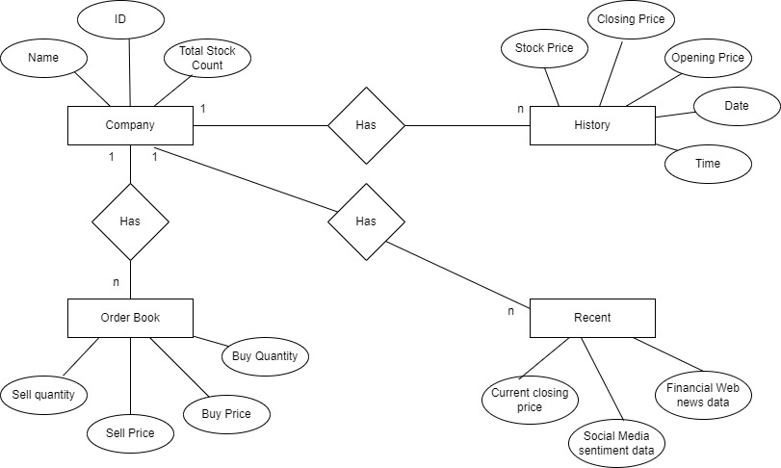

Slide 13
Results and Insights
Continuously monitoring the model's performance and update it as needed.
Provide insights into the direction of stock price movements.
Whether a stock is in an upward, downward, or sideways trend based on historical patterns.

Slide 14
THANK YOU…

